Slide 1
Requirement validation

Slide 2
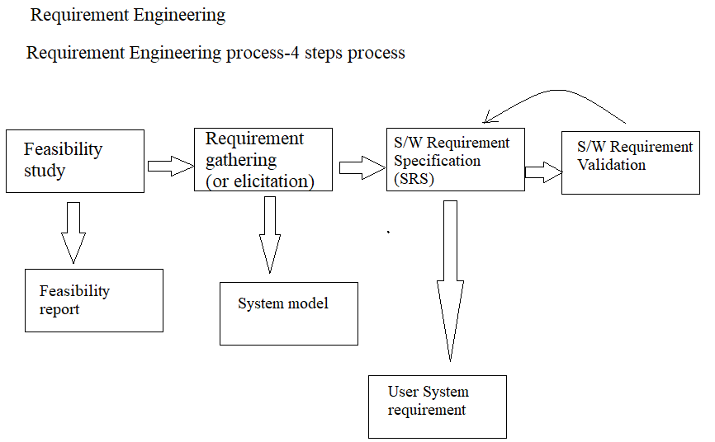
Requirement validation

Slide 3
Requirement Validation
Requirement validation checks the software requirements specification (SRS) against stakeholders goals and requirements
It ensures that the software being developed(or changed) will satisfy its stakeholders
It checks that the right products is being built.
Requirements error cost are high. So validation is very important
Fixing a requirement error after delivery may cost upto 100 times the cost of fixing an implementation error.

Slide 4
The development of software begins once the requirement document is ready.
One of the objective of this document is to check whether the delivered software system is acceptable.
For this it is necessary to ensure that the requirements specification contains no error and that it specifies the user’s requirement correctly.
If errors present in the SRS will adversely affect the cost if they are detected later in the development process when the software is delivered to the user.
Hence it is desirable to detect errors in the requirements before design and development of the software begins.
So,to check the issues related to requirements ,requirement validation is performed

Slide 5
Requirement Validation
Requirement validation is a technique in which the description in SRS document is verified for system implementation.
Checks mode on SRS document for.
1.Completeness and consistency
2.Conformance to standards
3.Requirements conflicts
4.Ambiguity in requirements.

Slide 6
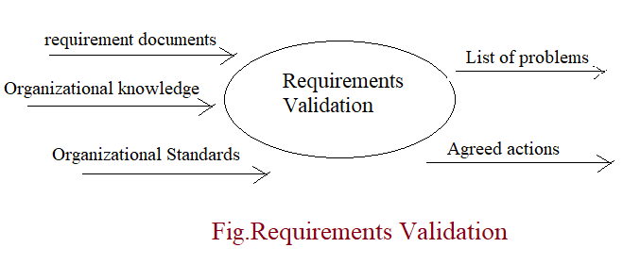

Slide 7
Inputs
The requirements document should be formulated and organized according to the standards of the organization.
The organizational knowledge is used to estimate realism of the requirements of the system.
The organizational standards are specified standards followed by the organizational according to which the system is to be developed.
Outputs
The list of problems indicate the problems encountered . In the requirements document of the requirement validation process.
The agreed actions is a list that displays the actions to be performed to resolve the problems shown in the problem list.

Slide 8
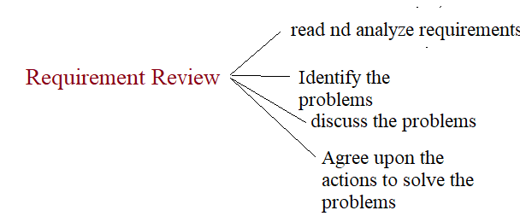
Requirements Validation Techniques
1.Requirements review:-
Systematic manual analysis of the requirements done by review team.
The review team consists of software engineers ,users and other stakeholders who examine the specification to ensure that the problems associated with consistency,omisssions and errors are detected and corrected.
Review team checks whether the work product produced during the requirements phase conform to the standards specified for the process,projects and product
Review team prepare a checklist from the requirement of items that need clarification or contain doubts before review meeting
Using the checklists, the participants specify the list of potential errors they have uncovered.

Slide 9
2.Prototyping:-
It is used for validating and eliciting new requirements of the system.
This helps to interpret assumptions and provide an appropriate feedback about the requirements to the user.
E.g. if user have approved a prototype, which consists of graphical user interface then the user interface can be considered validated.
3.Test case generation:-
Requirements specification in the SRS should be testable
If a test is difficult or impossible to design this usually means that the requirements will be difficult to implement and should be reconsidered /requires improvement.
4.Automated consistency analysis:-
It the requirements are expressed in the form of structured or formal notations then CASE tools can be used to check the consistency of the system.

Slide 10
DESIGN METRICS
In software development, a metric is the measurement of a particular characteristic of a program's performance or efficiency. Design metric measure the efficiency of design aspect of the software. Design model considering three aspects:
Architectural design
Object oriented design
User interface design
Architectural design :-The software needs the architectural design to represents the design of software. IEEE defines architectural design as “the process of defining a collection of hardware and software components and their interfaces to establish the framework for the development of a computer system.”

Slide 11
Object Oriented Design Metrics: There are nine measurable characteristics of object oriented design and those are:
Size: It can be measured using following factors:
Population: means total number of classes and operations.
Volume: means total number of classes or operation that is collected dynamically.
Functionality: is a measure of output delivered to the customer.
Complexity: It is measured representing the characteristics that how the classes are interrelated with each other.

Slide 12
Coupling: Number of messages that can be passed between the objects.
Completeness: It is a measure representing all the requirements of the design component.
Cohesion: It is a degree by which we can identified the set of properties that are working together to solve particular problem.
Primitiveness: The degree by which the operations are simple, i.e. number of operations independent from other.
Similarity: The degree by which we measure that two or more classes are similar with respect to their functionality and behavior.
Volatility: Is the measure that represents the probability of changes that will occur.

Slide 13
User Interface Design Metrics: Although there is significant literature on the design of human/computer interfaces, relatively little information has been published on metrics that would provide insight into the quality and usability of the interface.
Layout appropriateness (LA) is a worthwhile design metric for human/computer interfaces. A typical GUI uses layout entities—graphic icons, text, menus, windows, and the like—to assist the user in completing tasks. To accomplish a given task using a GUI, the user must move from one layout entity to the next.
Cohesion metrics can be defined as the relative connection of on screen content to other screen contents. UI cohesion for screen is high.

Slide 14
Thank you

